Slide 1

Statistics for CSAI II
9 – Multiple Regression and Categories
Travis J. Wiltshire |
1

Slide 2
Modules
Introduction and Probability
Sampling Theory
Revisiting Hypothesis Testing & Intro to Correlation
Correlation
Intro to Regression
More Regression Centering and Checking Assumptions
Multiple Regression and Assumptions
Interactions
Multiple Regression with Categories
Multiple Regression with Polynomials
Mixed Models
Growth Curve Analysis

Slide 3
Outline
Multiple Regression
Dummy Coding
Unweighted Effects
Weighted Effects
Contrast Coding
2

Slide 4




Simple vs. Multiple Regression
Y_{i} = b₀ + b₁X_{i} + ε_{i}
Y_{i} = b₀ + b₁X1_{i} + b₂X2_{i} + ... + b_{k}Xk_{i} + ε_{i}
One dependent variable Y predicted from one independent variable X
One regression coefficient
R²: proportion of variation in dependent variable Y predictable from X
One dependent variable Y predicted from a set of independent variables (X1, X2 ….Xk)
One regression coefficient for each independent variable
R²: proportion of variation in dependent variable Y predictable by set of independent variables (X’s)
A more in depth comparison here
3

Slide 5
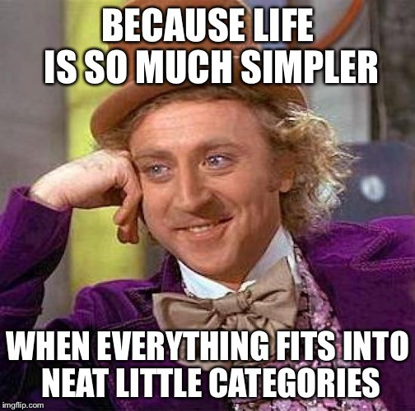
When do we need to think about categories for regression analysis?
If we have nominal or ordinal predictor variables consisting of multiple categories
If there are 2 or more groups/categories for our predictors
⇒ For regression modeling, we need to convert these categories into (sets of) numerical variables : code variables
4

Slide 6
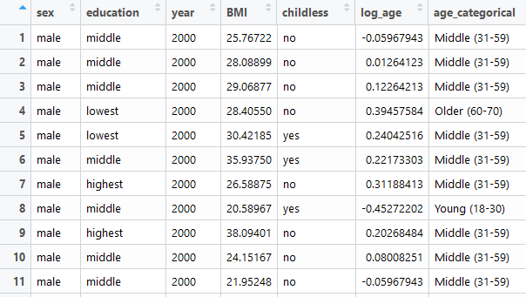
Coding Systems in Multiple Regression
All coding systems use g-1 code variables to represent g groups.
Each code variable represents a single distinction among the groups
All groups are
  Mutually exclusive (no individual in more than one group)
  Exhaustive (all individuals are in one of the groups)
5

Slide 7
Journal of Memory and Language 125 (2022) 104334
Contents lists available at ScienceDirect
Journal of Memory and Language
ELSEVIER
journal homepage: www.elsevier.com/locate/jml
Contrast coding choices in a decade of mixed models
Laurel Brehm*, Phillip M. Alday
MPIfor Psycholinguistics,Netherlands
Check for updates
A R T I C L E
I N F O
A B S T R A C T
Keywords: Contrasts Meta-science Mixed effect
Contrast codin in re ession mooe , in u in mix -e ect mo , c an es w at e terms in the mo mean.
In particular, it determines whether or not model terms should be interpreted as main effects. This paper
models
highlights how opaque descriptions of contrast coding have affected the field of psycholinguistics. We begin with a reproducible example in R using simulated data to demonstrate how incorrect conclusions can be made from mixed models; this also serves as a primer on contrast coding for statistical novices. We then present an analysis of 3384 papers from the field of psycholinguistics that we coded based upon whether a clear description of contrast coding was present. This analysis demonstrates that the majority of the psycholinguistic literature does not transparently describe contrast coding choices, posing an important challenge to reproducibility and repli- cability in our field.
Replication crisis

Slide 8
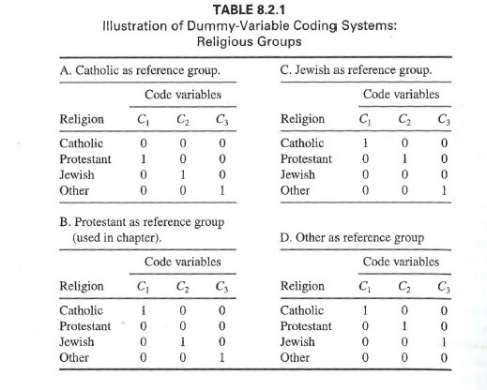
Dummy Coding
Reference group is assigned value
0 for every code variable
Considerations for selecting the reference group:
  A useful comparison (e.g., control group)
  Size of group should not be too small compared to size of other groups
The intercept of the reference
group is the mean of the reference group
Each (unstandardized) regression
coefficient is a comparison of
the mean of the group to the mean of the reference group.
7

Slide 9
Regression modelling with dummy coding
Install and load the ‘wec’ package
Load the ‘BMI’ data that is within that package (and check out the variables)
Check out the dummy.code() function from the psych package
Create a set of dummy coded variables for the education variable in the BMI data
Get some descriptive statistics on the data set
Create a linear model with your dummy codes as predictors of BMI (be sure to choose a referent group)
Check out and interpret the summary of the model
Run a correlation analysis of the dependent and predictor variables.

Slide 10
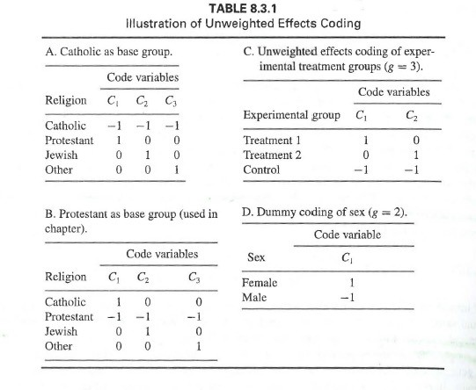
Unweighted Effects Coding
Used to compare how the outcome for
each group differs from the grand mean (mean of group means)
Unweighted = each group counts equally (independent of group size)
Base group gets all -1
  Group that is of least interest
Interpretation of coefficients :
  B₀ : unweighted mean of groups
- B_{i} : deviation of the outcome for group i to
the unweighted mean of groups
- The mean of the base group is defined as:
M = – B1 – B2 – B3…B_{i} + B0
9

Slide 11
Run a model with unweighted effects codes
Try out the contr.sum() function to generate effects coding matrices for variables with 3 and 4 groups
Run a linear model with:
  BMI as the outcome,
  Education as the predictor
  Figure out how to use the contrasts argument of lm() by creating a list that includes the contr.sum for the education variable
Generate and interpret the summary
Get the mean of the base group

Slide 12
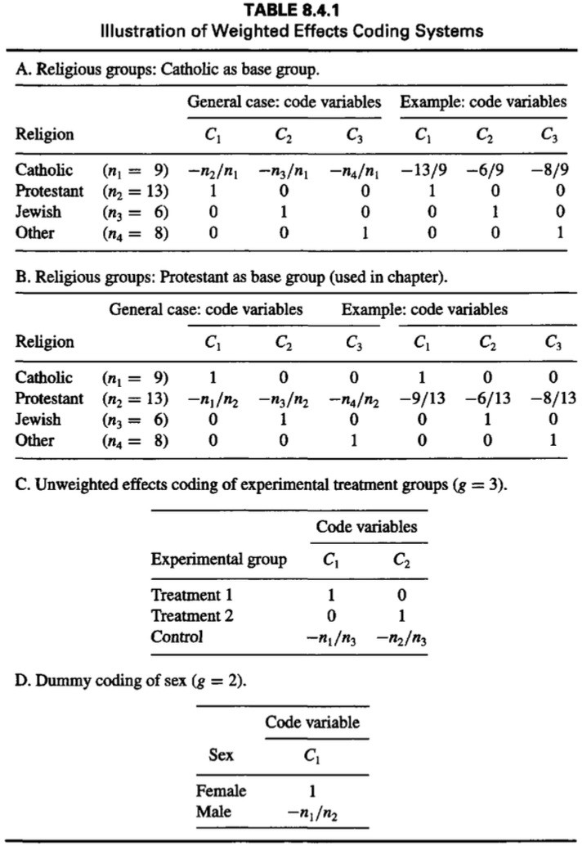
Weighted Effects Coding
Used to compare how the outcome for each group differs from the weighted mean (mean of group means weighted by group size)
Useful when the proportion of cases from each group ‘represents’ the population
  (e.g., ethnic makeup, cognitive ability, …)
Or when sample size of groups differs a lot
Base group (group of least interest)
  Minus the ratio of group i and base group size
  Same as unweighted (-1) if group sizes are equal
11

Slide 13
Run a model with weighted effects codes
Make a weighted contrast matrix using the contr.wec() function from wec package
Make two new variables the represent contrasts either omitting the ‘lowest’ or highest’ education group
Now run two models including those new variables
Generate summaries, interpret, and compare

Slide 14
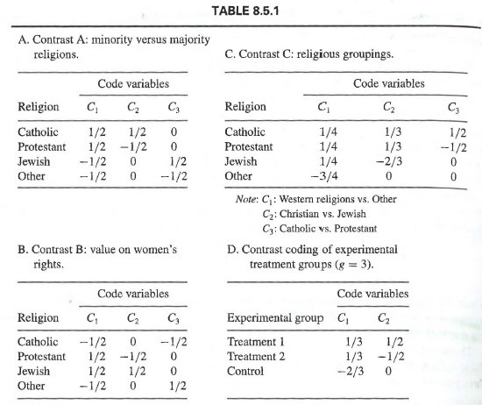
Contrast Coding
When there are mean expected
differences between groups or combinations of groups
Good for testing specific hypotheses
  E.g., group a + b will be less than group c
Can increase power of the statistical analysis
Rules
  1. For each code variable, sum of weights across all groups must equal 0
  2. Sum of the products of each pair of code variables must equal 0
  3. Difference between positive set of weights
and negative set should equal 1 for each code variable (for ease of interpretation)
13

Slide 15
Run a model with contrast codes
Create a matrix that allows you to compare the lowest education to the middle and highest matrix (hint: see Table 8.5.1 D)
Run the model including this matrix in the contrasts arguments
Generate and interpret the summary

Slide 16
More coding systems
There are many more types of coding systems
https://stats.idre.ucla.edu/r/library/r-library-contrast-coding- systems-for-categorical-variables/
Next week:
- Polynomial regression
15

Slide 17
Preparing for Module 10: Multiple Regression with Polynomials
Read: Polynomial Regression Model: An Example (PDF of former webpage)

Slide 18
Thanks! See you next week! Questions?
Material from Cohen et al CH 8
16

